Slide 1
IntelliJ4Life - CHAD P3
Ryan “Sly” Williams,
Chris “Chris” Haynes,
Scott “Sweny” Swensen,
Colton “Coltron” Larson,
Sandeep “Sandman” Chundru

Slide 2
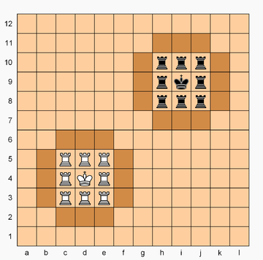
Chad (recap)
Each player owns a 3x3 castle surrounded by 12 squares of walls.
Rooks and queens move unimpeded by castles and walls.
If a rook ends in an enemy castle, it is promoted to a Queen.
The king can move and capture in the same way as a chess king or knight
Kings cannot leave their castle and can capture any enemy piece in the castle.

Slide 3
Chad (recap)
A rook or queen may capture an opponent's rook or queen only when one of these pieces is on the enemy's wall, and the other piece is in its own castle. This is the only scenario in which rooks and queens can capture.
In other situations rooks and queens cannot capture, and simply block one another's movement.
Castle walls do not block check

Slide 4
Required Tools/Technologies
Git / GitHub
Java 1.8
JUnit 5
Maven
React js
Node js
IntelliJ

Slide 5

Most Important Tool
Trying
Your
Best

Slide 6
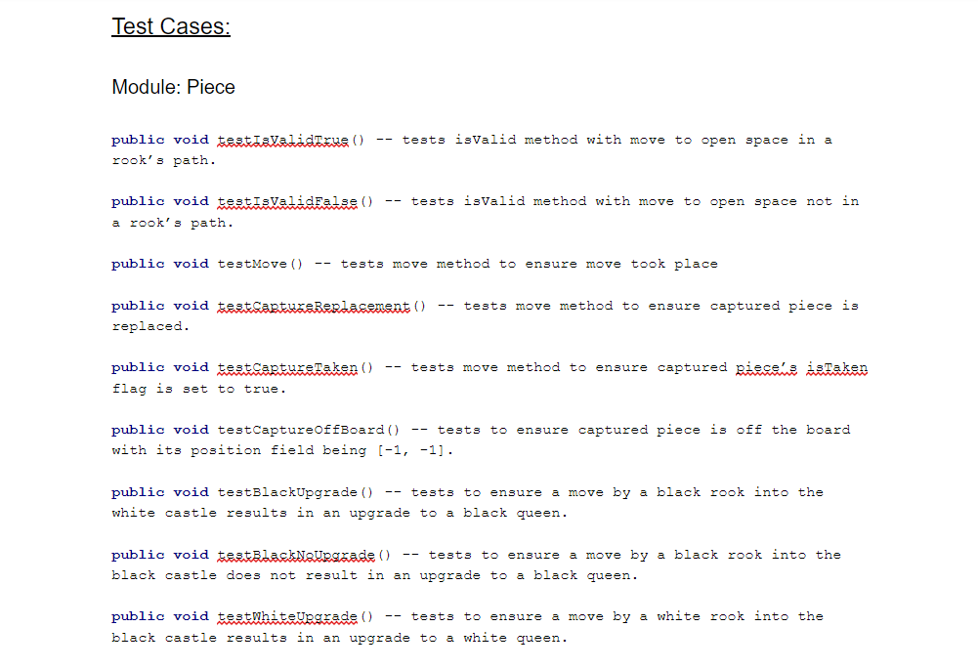
Testing Document

Slide 7
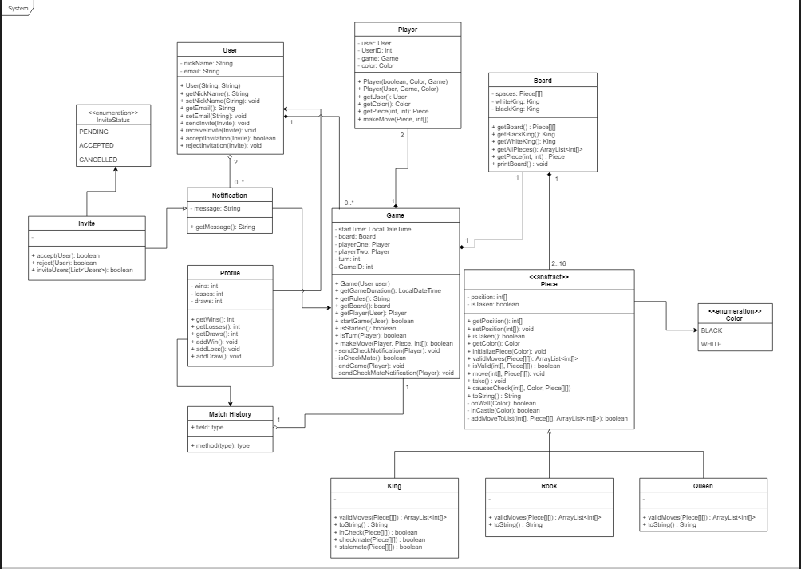

Slide 8
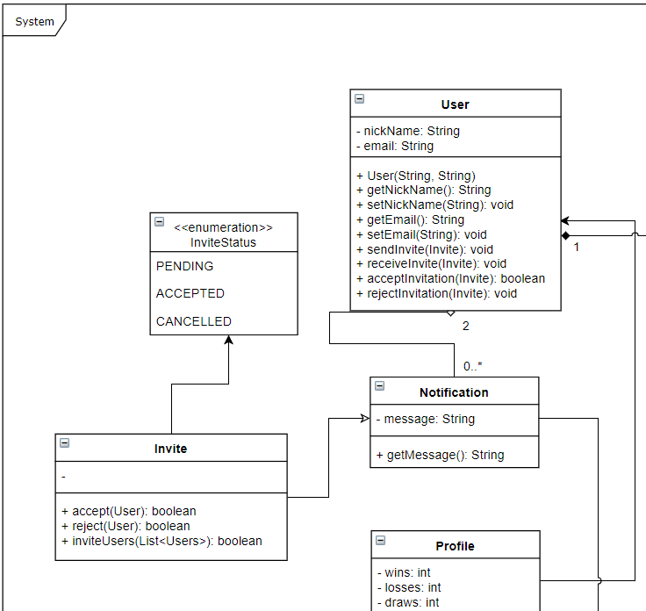
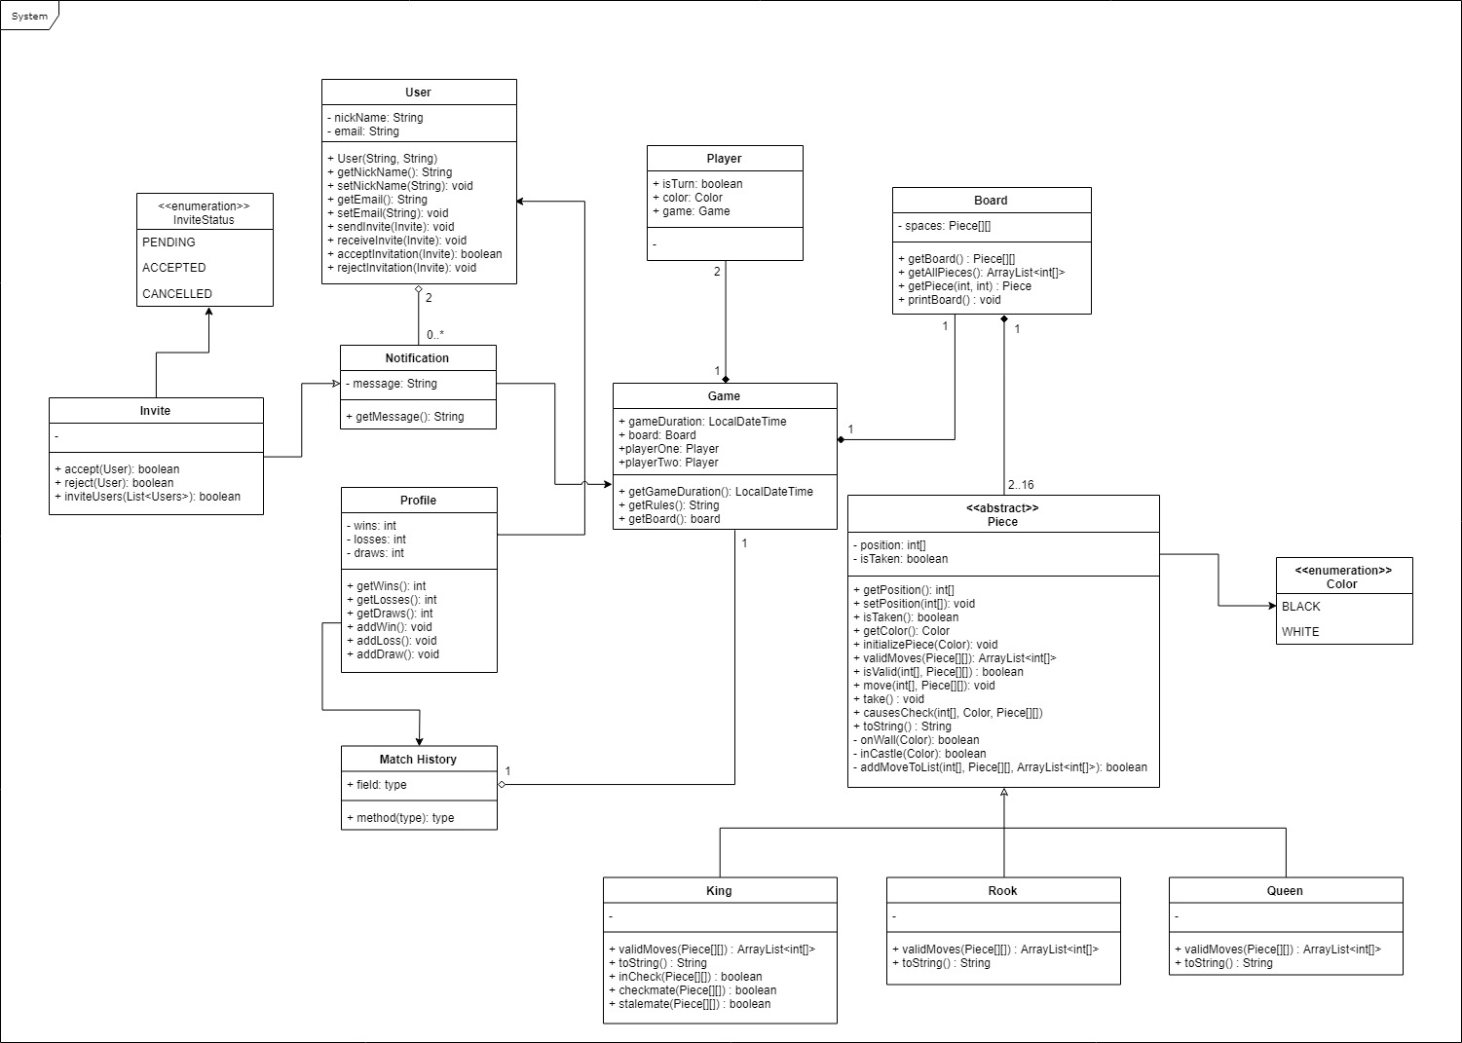
Class Diagram
Parts

Slide 9
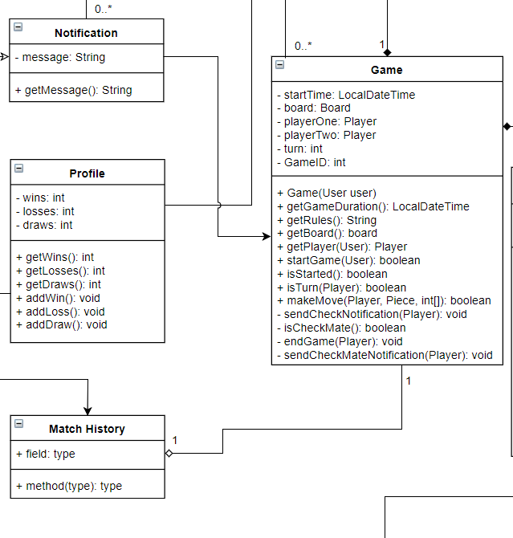
Class Diagram
Parts

Slide 10
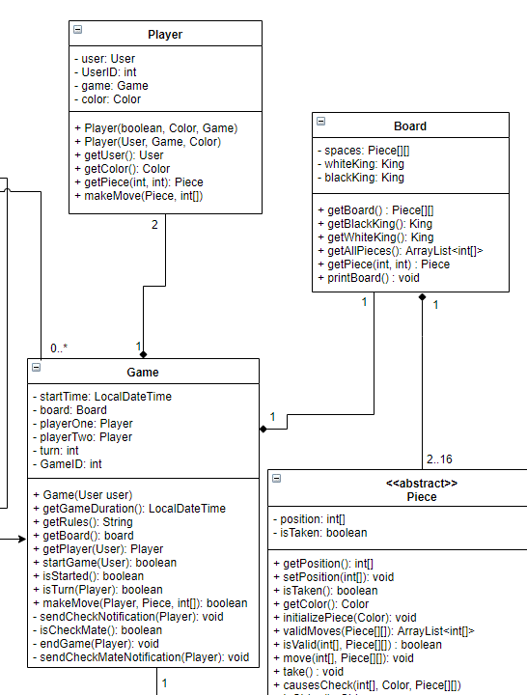
Class Diagram
Parts

Slide 11
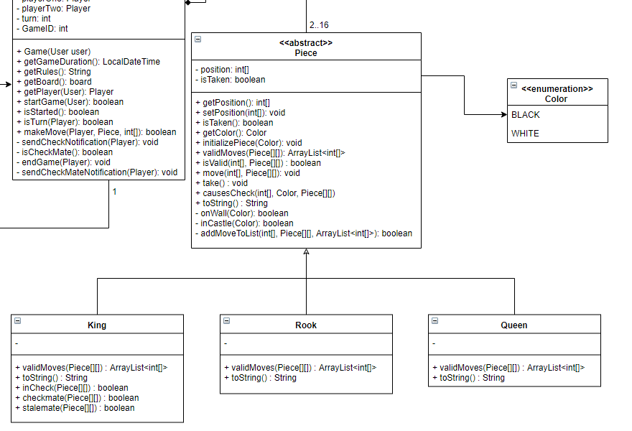
Class Diagram
Parts

Slide 12
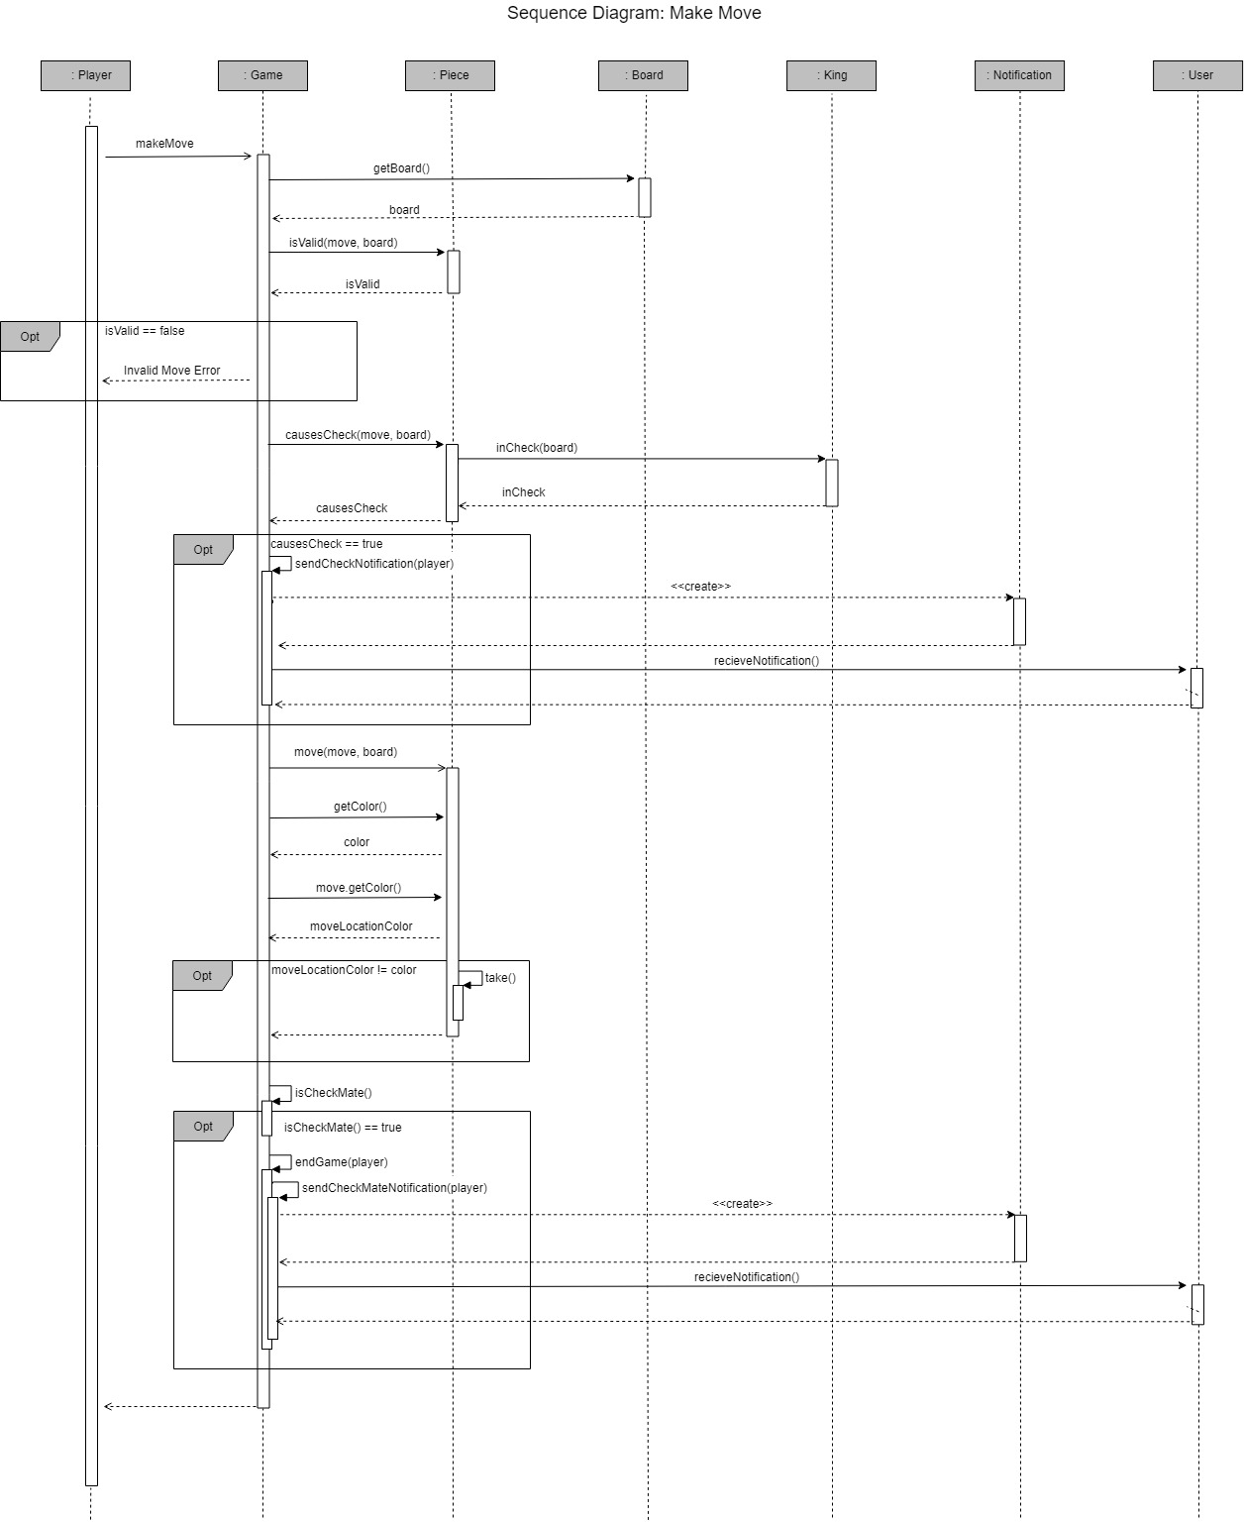
Sequence
Diagram:
Make Move

Slide 13
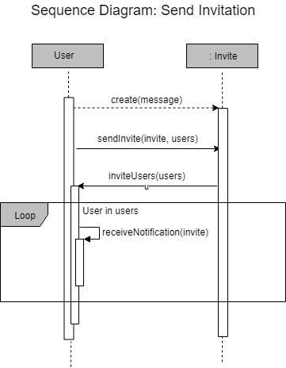
Sequence
Diagram:
Send Invitation

Slide 14
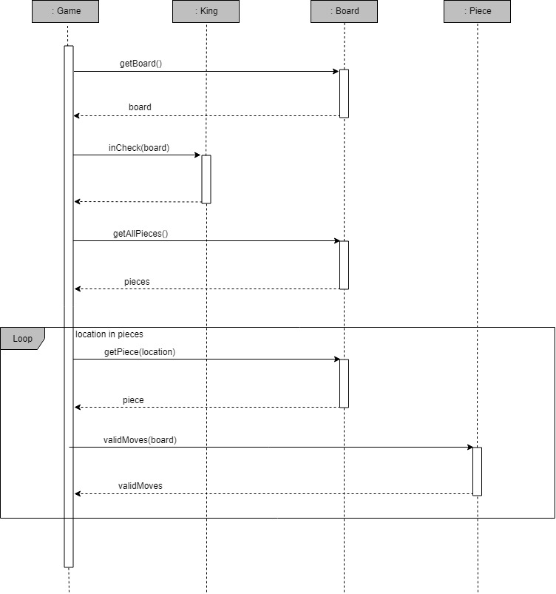
Sequence
Diagram:
Test Checkmate

Slide 15
Traceability Matrix
 | 1 | 2 | 3 | 4 | 5 | 6 | 7 | 8 | 9 | 10 | 11 | 12 | 13 | 14 | 15 | 16
Session |  | X | X |  |  |  |  |  |  |  |  | X |  |  |  | X
User | X |  | X | X | X |  | X |  |  | X |  |  | X | X | X | X
Profile |  |  |  |  |  |  | X | X | X
Notification |  |  |  | X | X |  |  |  | X
Invite |  |  |  | X | X |  |  |  |  | X |  |  | X | X |  | X
Player | X |  |  |  | X | X |  | X | X | X | X
Game | X |  |  |  | X | X |  | X | X | X | X
Board |  |  |  |  | X | X
Piece |  |  |  |  | X | X
Switch Game
Register User
Unregister User
Reject Invitation
5. Create Game
6. Make Move
7. View Profile
8. End Game
9. Quit Game
10. Join Game
11. Play Game
12. Log In
13. Cancel Invitation
14. Accept Invitation
15. Interact with Invitation
16. Invite Players

Slide 16
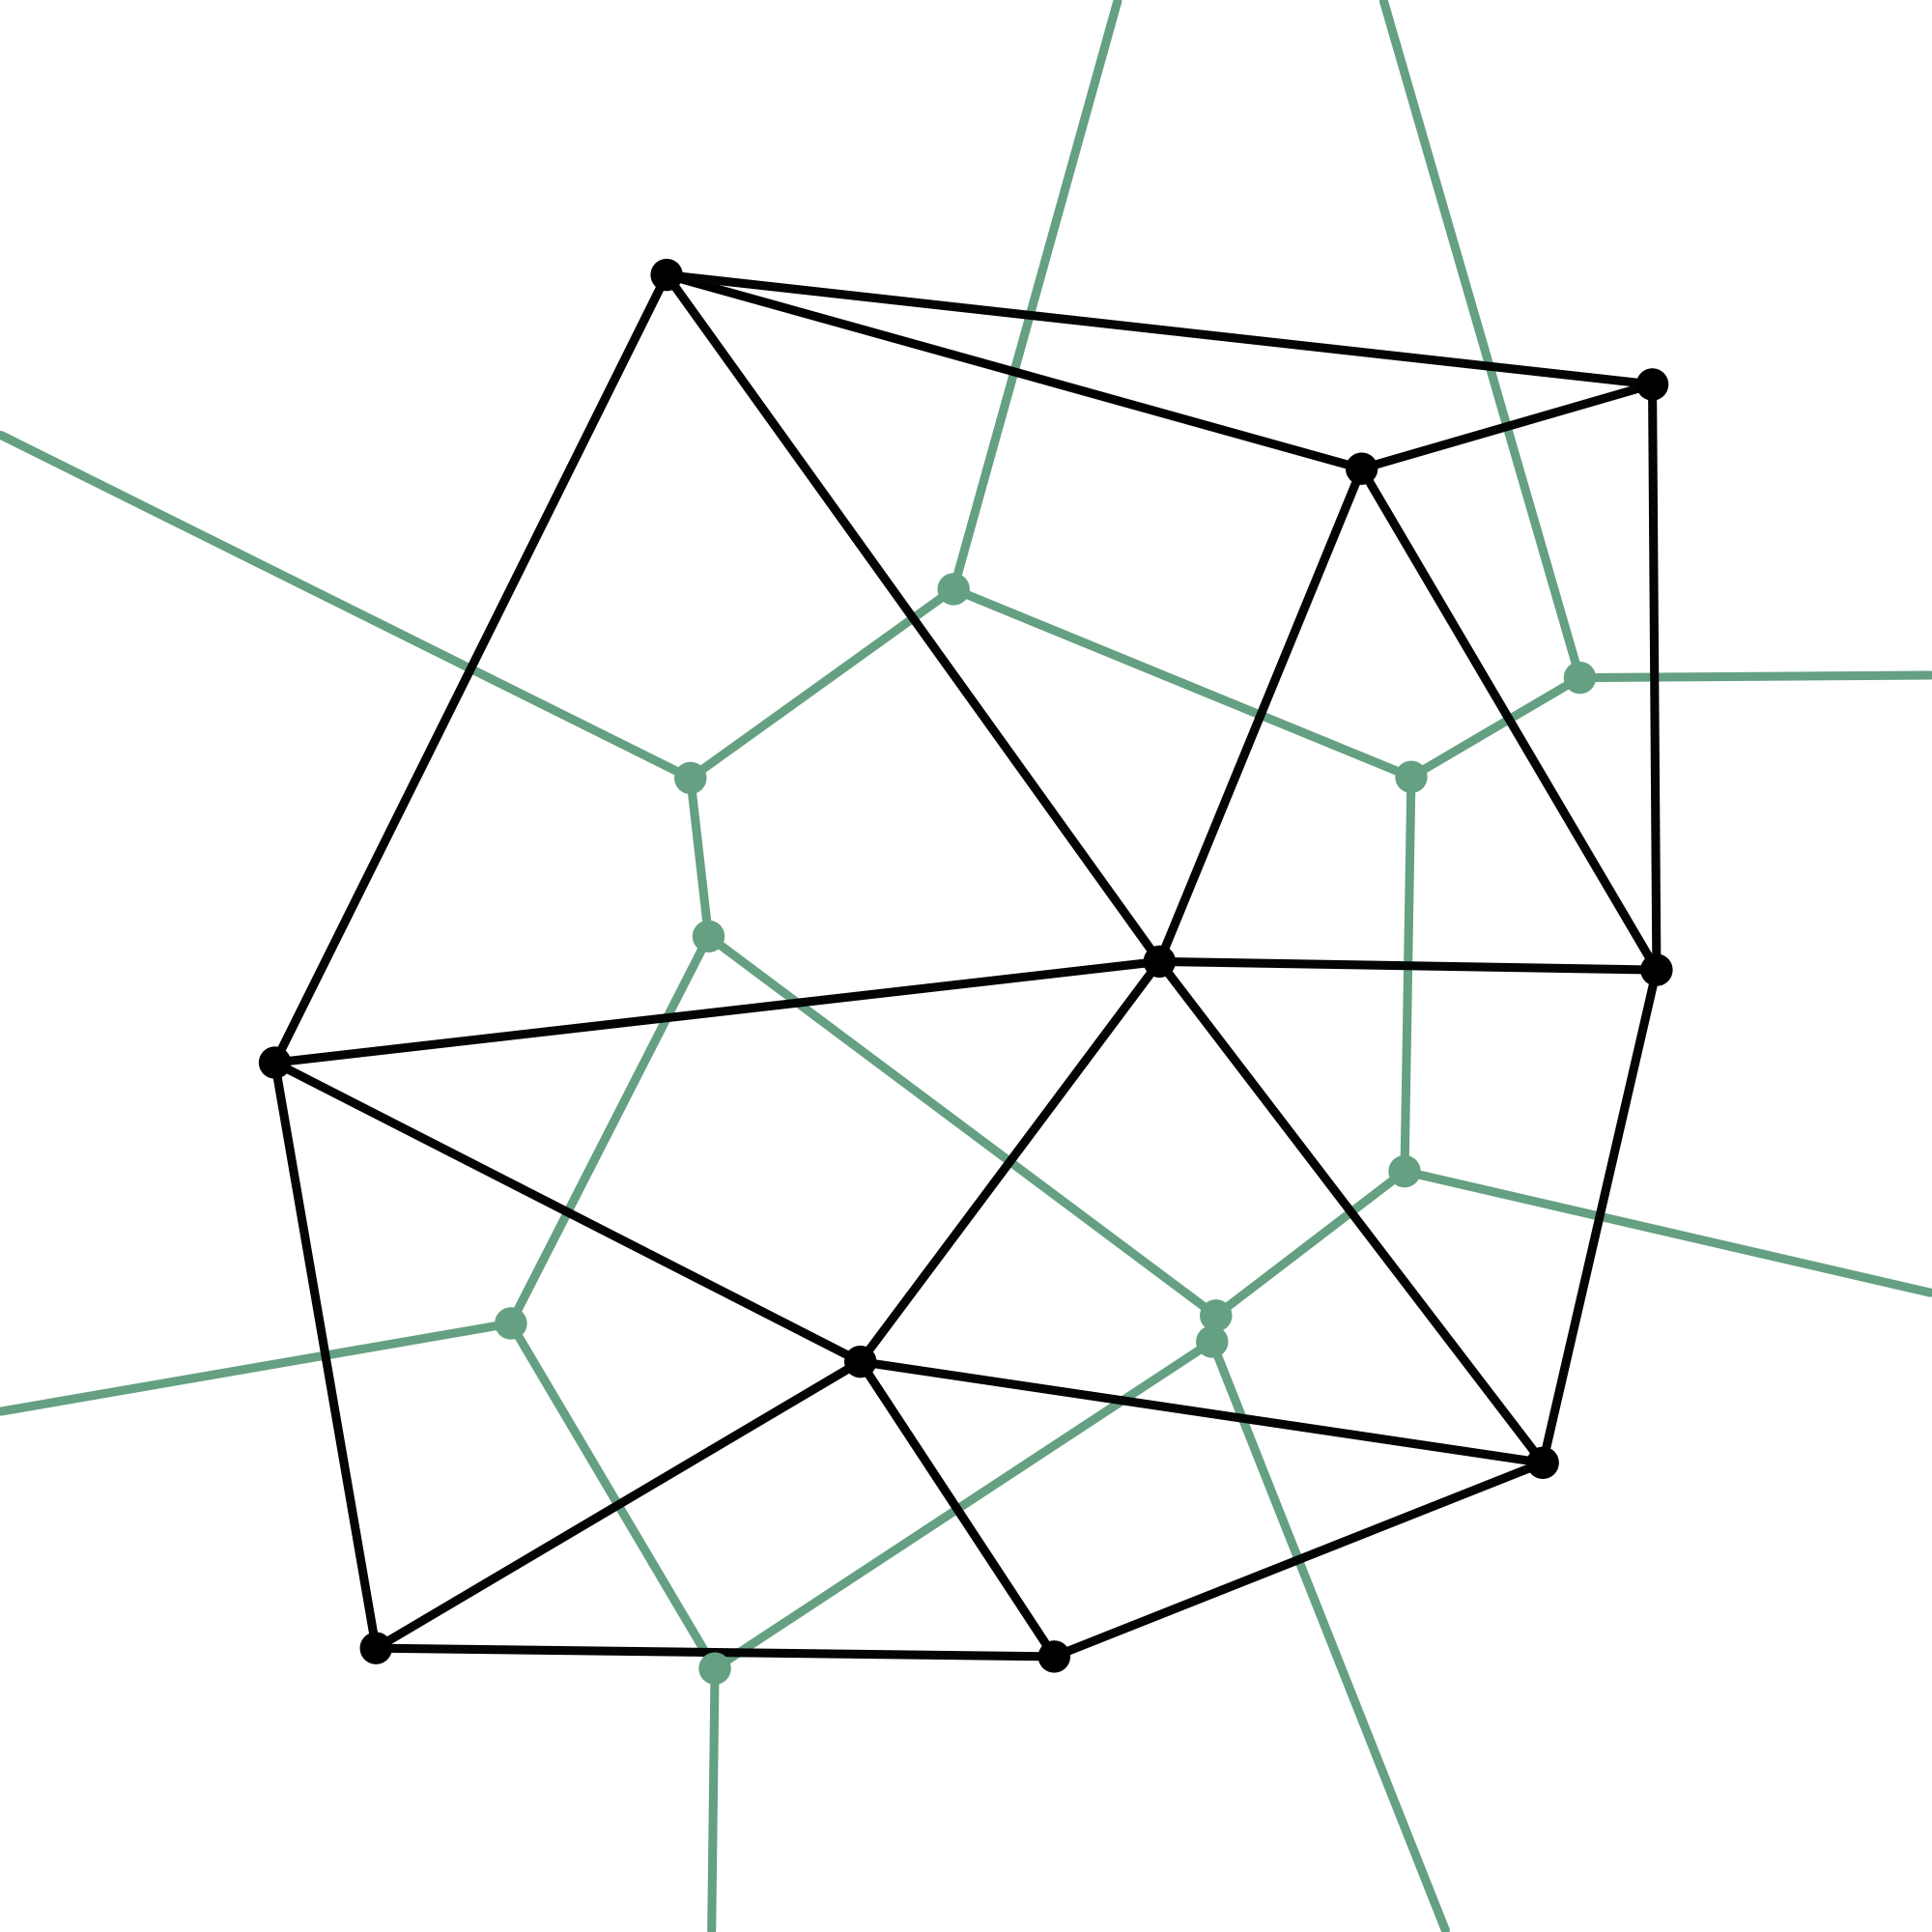
DEMO

